Slide 1
IP Services
Learning Outcomes:
Network Time Protocol (NTP)
Precision Time Protocol (PTP)
First Hop Redundancy Protocol (FHRP)
Network Address Translation (NAT)

Slide 2
1. Network Time Protocol
Need for Time Synchronization:
Time based password change / Ephemeral
Encryption key exchanges
Certificate validation is based on date and time
Network or Security based devices correlation
Troubleshooting events and correlating syslog messages
NTP is used to synchronize set of network clocks in a distributed client/server architecture.
Uses server port 123, over UDP
Hierarchical communication concept
Authoritative devices (Servers) connected to atomic clock is at the root of hierarchy.

Slide 3
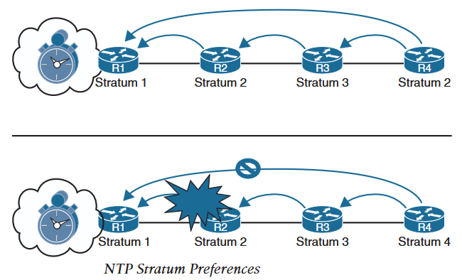
1. Network Time Protocol
Stratum as hierarchy of the time source
Root of hierarchy is Stratum 1 server
Clients connected to stratum 1 server are stratum 2 and so on.
Higher the stratum, higher the deviation
NTP client configured with multiple servers prefers server with low stratum, while keeping other as backup.

Slide 4
1. Network Time Protocol
NTP Configuration:
ntp server ip-address [prefer] [source interface-id]
ntp server
Core-router# config t
Enter configuration commands, one per line. End with CNTL/Z.
Core-router(config)# no ntp server
Core-router(config)# ntp server time1.google.com
Core-router(config)# ntp server time2.google.com
Core-router(config)# ntp server time3.google.com
Core-router(config)# ntp server time4.google.com
Or use NTP pool for ntp servers.
To set the stratum number of a server statically:
ntp master stratum-number
Router# config t
Core-router(config)# ntp master 1
To view status of NTP service:
Show ntp status

Slide 5
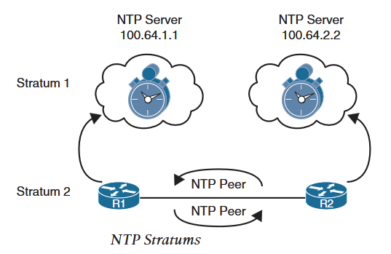
1. Network Time Protocol
NTP Peers: A common practice is to use two internal network devices to query external NTP servers
Such as R1 queries timex.google.com and R2 queries x .pool.ntp.org (x=0,1,2,3...)
R1 and R2 are then peered to synchronize time with each other.
Peer configuration:
R1(config)# ntp peer R2-loopback-ip
R2(config)# ntp peer R1-loopback-ip
Peers act as server and client for each other
Peers can adjust a maximum of 2 minutes drift per query

Slide 6
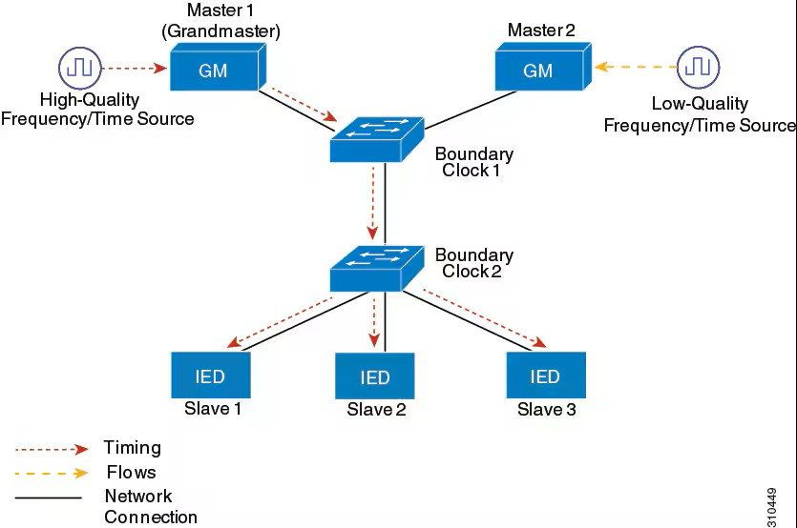
2. Precision Time Protocol
PTP is more accurate timing protocol that accounts for path delay between time source and reciver.
It uses PTP messages to calculate the communication path delay.
PTP version 2 messages are categorized as event messages and general messages.
Event messages are tagged with timestamps when leaving ports and those timestamps are used to calculate link delay.
Event messages: Sync, delay_Req, (Path) Pdelay_Req, Pdelay_Resp
General messages are not timestamp tagged and are used to establish PTP hierarchy(Master-Slave) : Announce, Follow_up, delay_resp, pdelay_resp_follow_up
In the figure below, Master 1 is the Grandmaster (GM), switches are Boundary Clocks and intelligent devices (IEDs) are Slave.
On GM (Master1) failure, slaves switch to Master 2.

Slide 7
2. Precision Time Protocol
PTP clocks:
Grandmaster Clock : Primary source of clock for synchronization.
It can have a precise external time source such as GPS or atomic clock or can have a free run with it's own system clock.
Ordinary Clock: PTP clock with single PTP port. Most common clocks in PTP network that functions as a node and can act as parent or member.
Boundary Clock: Intermediary PTP clock between Grandmaster and it’s clients that operates in a standard switch or router and has more than one PTP port.
They terminate PTP messages from grandmaster and regenerate them for it’s client.
They intercept and process all PTP messages to select best clock using Best Master Clock Algorithm (BMCA) among the ones seen on all PTP ports.
Selected best port is set as Slave and other ports are set as Master. Slave port is used to synchronize with upstream master clock and Master port is used to synchronize downstream clocks.
Use command ptp role primary under interface configuration mode to set a port as master (primary) permanently. Setting a port as master permanently ensures that the port will remain as master even if a clock that can be a grandmaster is connected to the port.
Transparent Clock: It updates the time-interval field of PTP event messages without regenerating them. This update compensates for switch delay and has accuracy within 1 picoseconds.
Two types of Transparent clocks:
end-to-end (e2e) transparent clock measures event message transit time for sync and delay_req messages.
peer-to-peer (p2p) transparent clock measure event message transit time and upstream link delay.
These calculated times are added to the correction field of the those respective messages and slaves use it to calculate offsets using transit time and total path delay using upstream link delay.

Slide 8
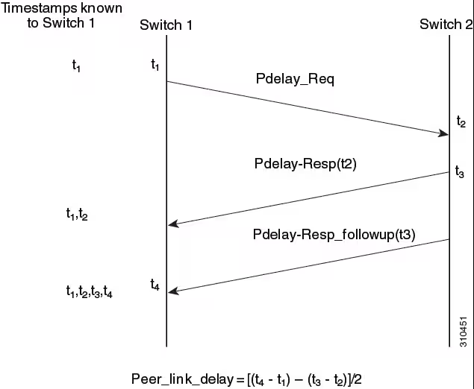
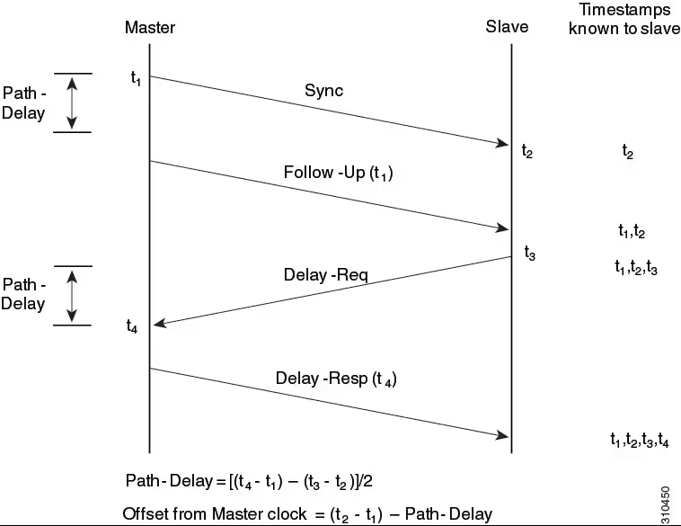
2. Precision Time Protocol
PTP Event message sequences:
End-to-End Delay Mechanism: Boundary clocks and Ordinary clocks configured with Request-Response mechanism use following message sequence to generate and communicate timing information.
Master sends Sync message to Slave at t1.
Slave receives Sync message and notes the time it received it as t2.
Master sends the timestamp t1 to Slave in a Follow_up message.
Slave sends a Delay_Req message to Master at timestamp t3.
Master receives the Delay_Req at t4 and sends that timestamp to Slave in Delay_Resp message.
Slave receives all four timestamps and calculates Path-Delay and offset from Master clock.
Peer-to-Peer Delay Mechanism: Boundary clocks at multiple levels of the network with non-PTP devices inbetween them decreases the synchronization accuracy. Boundary/Transparent clocks use below message sequences to calculate path delay between them.
Port 1 (Switch1) generates a Pdelay_req message at t1.
Port 2 (Switch2) receives the Pdelay_req message at t2.
Port 2 sends the t2 to Port 1 in Pdelay_Resp message at t3.
Port 2 sends t3 to Port 1 in a Pdelay_Resp_Follow_Up message
Port 1 receives the Pdelay_Resp_Follow_Up message at t4.
Port 1 uses t1,t2,t3 and t4 to calculate peer-to-peer link dealy.

Slide 9
2. Precision Time Protocol
Best Master Clock Algorithm (BMCA): BMCA identifies the best master clock in a sub-domain of all the PTP clock it sees, including itself.
BMCA runs locally on each port for every Announce interval to quickly adjust to the network changes.
BMCA uses Announce message to advertise clock properties.
BMCA uses own data set with received data set to determine best master clock in the following order:
Priority1: User assigned priority to each clock. Default is 128 and range is from 0 to 255.
Class: Class to which the clock belongs to.
Accuracy: Precision between the clock and UTC in nanoseconds.
Variance: Variability of clock
Priority2: Final priority. Range is from 0 to 255, default is 128.
Unique Identifier: 64-bit Extended Unique Identifier (EUI) of sender and receiver
Additionally, BMCA eliminates master clock conflict by ensuring two master clock or no master does not exists in the network. And clocks do not have to negotiate with each other.
PTP profiles: Set of allowed PTP features applicable to a device. PTP profile defines below values:
BMCA Options
Configuration Management options
Path delay mechanism (peer delay)
Range and default values of PTP configurable attributes and data set members
Closest clock to grandmaster
Transport mechanism required, permitted or prohibited.
Node types required, permitted and prohibited
Options required, permitted and prohibited
Default profile mode on a device is default profile with layer 2 and layer 3 transport. Default profile is disabled globally on devices.

Slide 10
2. Precision Time Protocol
PTP configuration : Configure layer 2 default profile
On global config, command ptp mode {boundary {delay-req | pdelay-req } | e2etransparent | p2ptransparent} specifies the synchronization mode.
Example: configure one of the three modes from below
Device(config)# ptp mode boundary delay-req
Device(config)# ptp mode boundary pdelay-req
Device(config)# ptp mode e2etransparent
Device(config)# ptp mode p2ptransparent
Boundary mode: participates in best master clock selection. If no better clock detected, it becomes grandmaster and acts as parent to other clocks in the network. If there is best master clock attached to it, it synchronizes with it as a child and acts as a parent to other clocks attached to it.
e2etransparent mode: This is default mode where all ports on the device synchronizes with a grandmaster connected to it. This mode causes less error and error accumulation than boundary mode as it corrects the delay and jitter caused by packets passing through it (known as resident time).
p2ptransparent mode: switch does not synchronizes with grandmaster and does not participate in master selection.
Enabling PTP default profile globally with above command enables it on all the ports. To disable on a port use, no ptp enable command under interface configuration mode.
Configure ptp domain with command ptp domain domain-value
domain-value range from 4 to 127. no ptp domain sets to default value of 0.
example: Device(config)# ptp domain 8
PTP Configuration: Layer 3 default profile
Configure ptp transport mode with command ptp transport ipv4 udp
ipv4 udp is the only supported transport mode. Example:
Device(config)# ptp transport ipv4 udp
Specify synchronization clock mode with command ptp mode {boundary {delay-req|pdelay-req} | e2etransparent | p2ptransparent }
With default profile ptp messages are processed in vlan 1 by default. On a trunk port ptp vlan is by default processed in native vlan.Set ptp vlan on a trunk port with command ptp vlan vlan-id under interface configuration mode.

Slide 11
3. First Hop Redundancy Protocol (FHRP)
Layer 2 resiliency is achieved with multiple switches and links.
Layer 3 resiliency is achieved with multiple routes.
Object Tracking :
FHRP only works when there is any issue in the data path downstream from the gateway towards end devices or one of the gateway goes down.
It does not know if any upstream links goes down and there is no path outward from the gateway.
Object tracking can be used to track upstream links and routes (objects) status.
Change in object's status then can be used to trigger certain actions.
Example:
To track upstream route:
track object-number ip route route/prefix-length reachability
track 1 ip route 100.10.10.1/32 reachability
To track upstream interface line-protocol up/down:
track object-number interface interface-id line-protocol
track 2 interface GigabitEthernet 0/1 line-protocol

Slide 12
3. First Hop Redundancy Protocol (FHRP)
Types of FHRP:
Hot Standby Router Protocol (HSRP):
Cisco proprietary protocol that requires minimum of two devices.
One acts as ACTIVE and another as STANDBY
Both router is configured with Virtual IP (VIP) as a default gateway to end devices.
And a virtual MAC belonging to VIP is assigned to both device.
By default, there is no pre-emption during failover.
HSRP inter-router communication is via UDP Hello messages on multicast address 224.0.0.2 (HSRPv1) and 224.0.0.102 (HSRPv2)
MAC address range 0000.0C07.ACxy (HSRPV1),xy is group number in hex range from 0 to 255 and 0000.0C9F.F000 to 0000.0C9F.FFFF (HSRPv2) group range from 0 to 4095.

Slide 13
3. First Hop Redundancy Protocol (FHRP)
Virtual Router Redundancy Protocol (VRRP):
Active router is MASTER and standby is BACKUP
Preemption enabled by default
Uses multicast address of 224.0.0.18 and MAC address 0000.5e00.01xx, xx reflects group ID in Hex.
VRRP has two version, VRRPv2 and VRRPv3
VRRPv2 is not hierarchical in configuration supports only ipv4 whereas, VRRPv3 is hierarchical in configuration and supports ipv4 and ipv6.
Fhrp version VRRP v2/v3 global command.
Then apply VRRP in interfaces.
VRRP v3 choose address family in interface command.

Slide 14
3. First Hop Redundancy Protocol (FHRP)
Gateway Load Balancing Protocol (GLBP):
Provides both redundancy and load balancing
GLBP group members have 2 roles:
Active Virtual Gateway (AVG):
Elected per GLBP group to reply to an initial ARP request for VIP.
AVG replies with virtual MAC of AVF to ARP request.
Active Virtual Forwarder(AVF):
Unique virtual MAC is created by AVG and is assigned to AVF.
AVF forwards traffic from hosts assigned to it.
AVFs are recognised in a router as a FWD instances.
Supports four active AVFs and 1 AVG per group
AVG Active device failovers to AVG Standby
AVF failure is taken over by other AVFs in the group.
GLBP load balancing models:
Round Robin: Forwarder assigned in round robin manner.
Weighted: Forwarder assigned based on set weight. Weight lower is the minimum required to remain Active forwarder. Weight upper is the value the forwarder must be restored to, to be Active forwarder again.
Host dependent: Uses same forwarder for source MAC address

